Slide 1
Unit 4
The Urinary System

Slide 2
Functions of the Urinary System
Elimination of waste products
  Nitrogenous wastes
  Toxins
  Drugs
Copyright © 2003 Pearson Education, Inc. publishing as Benjamin Cummings
Slide 15.1a

Slide 3
Functions of the Urinary System
Regulate aspects of homeostasis
  Water balance
  Electrolytes
  Acid-base balance in the blood
  Blood pressure
  Red blood cell production
  Activation of vitamin D
Copyright © 2003 Pearson Education, Inc. publishing as Benjamin Cummings
Slide 15.1b

Slide 4
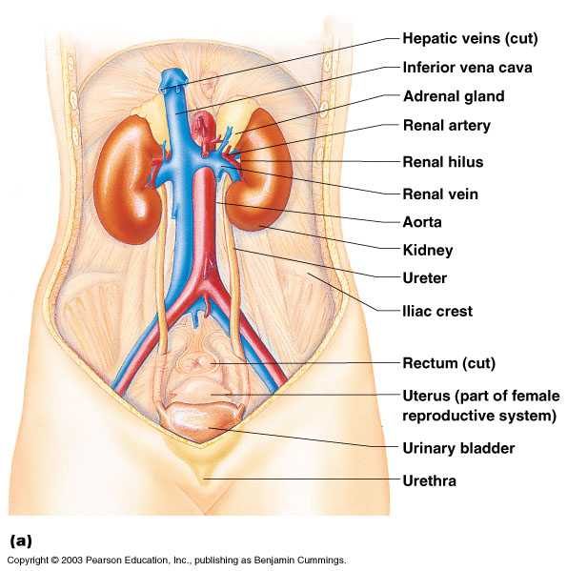
Organs of the Urinary system
Kidneys
Ureters
Urinary bladder
Urethra
Figure 15.1a
Copyright © 2003 Pearson Education, Inc. publishing as Benjamin Cummings
Slide 15.2

Slide 5
Location of the Kidneys
Against the dorsal body wall
At the level of T₁₂ to L₃
The right kidney is slightly lower than the left
Attached to ureters, renal blood vessels, and nerves at renal hilus
Atop each kidney is an adrenal gland
Copyright © 2003 Pearson Education, Inc. publishing as Benjamin Cummings
Slide 15.3

Slide 6
Coverings of the Kidneys
Renal capsule
  Surrounds each kidney
Adipose capsule
  Surrounds the kidney
  Provides protection to the kidney
  Helps keep the kidney in its correct location
Copyright © 2003 Pearson Education, Inc. publishing as Benjamin Cummings
Slide 15.4

Slide 7
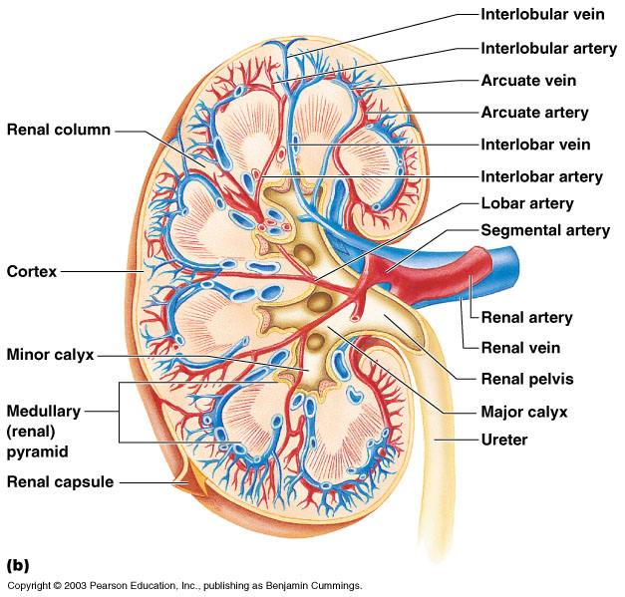
Regions of the Kidney
Renal cortex – outer region
Renal medulla – inside the cortex
Renal pelvis – inner collecting tube
Copyright © 2003 Pearson Education, Inc. publishing as Benjamin Cummings
Figure 15.2b
Slide 15.5

Slide 8
Kidney Structures
Medullary pyramids – triangular regions of tissue in the medulla
Renal columns – extensions of cortex-like material inward
Calyces – cup-shaped structures that funnel urine towards the renal pelvis
Copyright © 2003 Pearson Education, Inc. publishing as Benjamin Cummings
Slide 15.6

Slide 9
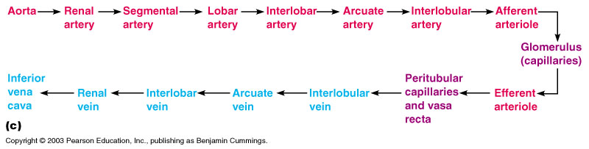
Blood Flow in the Kidneys
Figure 15.2c
Copyright © 2003 Pearson Education, Inc. publishing as Benjamin Cummings
Slide 15.7

Slide 10
Nephrons
The structural and functional units of the kidneys
Responsible for forming urine
Main structures of the nephrons
  Glomerulus
  Renal tubule
Copyright © 2003 Pearson Education, Inc. publishing as Benjamin Cummings
Slide 15.8

Slide 11
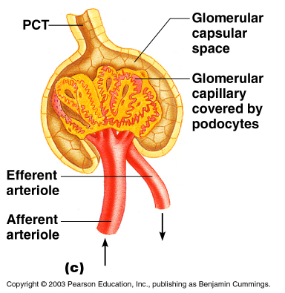
Glomerulus
A specialized
capillary bed
Attached to
arterioles on both sides (maintains
high pressure)
  Large afferent
  arteriole
  Narrow efferent
  arteriole
Figure 15.3c
Copyright © 2003 Pearson Education, Inc. publishing as Benjamin Cummings
Slide 15.9a

Slide 12
Glomerulus
The glomerulus sits within a glomerular capsule (the first part of the renal tubule)
Figure 15.3c
Copyright © 2003 Pearson Education, Inc. publishing as Benjamin Cummings
Slide 15.9b

Slide 13
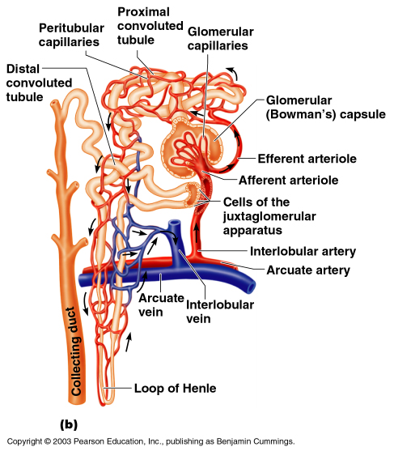
Renal Tubule
Glomerular (Bowman’s) capsule
Proximal convoluted tubule
Loop of Henle
Distal convoluted tubule
Copyright © 2003 Pearson Education, Inc. publishing as Benjamin Cummings
Figure 15.3b
Slide 15.10

Slide 14
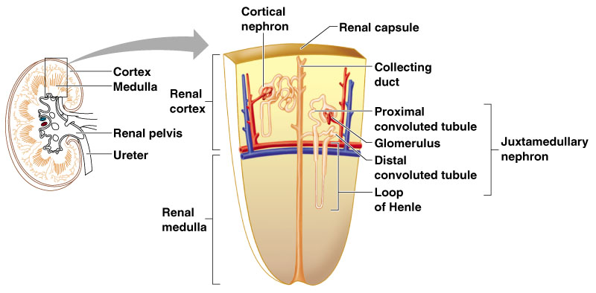
Types of Nephrons
Cortical nephrons
  Located entirely in the cortex
  Includes most nephrons
Figure 15.3a
Copyright © 2003 Pearson Education, Inc. publishing as Benjamin Cummings
Slide 15.11a

Slide 15
Types of Nephrons
Juxtamedullary nephrons
  Found at the boundary of the cortex and medulla
Figure 15.3a
Copyright © 2003 Pearson Education, Inc. publishing as Benjamin Cummings
Slide 15.11b

Slide 16
Peritubular Capillaries
Arise from efferent arteriole of the glomerulus
Normal, low pressure capillaries
Attached to a venule
Cling close to the renal tubule
Reabsorb (reclaim) some substances from collecting tubes
Copyright © 2003 Pearson Education, Inc. publishing as Benjamin Cummings
Slide 15.12

Slide 17
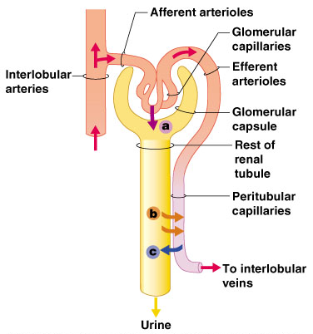
Urine Formation Processes
Filtration
Reabsorption
Secretion
Figure 15.4
Copyright © 2003 Pearson Education, Inc. publishing as Benjamin Cummings
Slide 15.13

Slide 18
Filtration
Nonselective passive process
Water and solutes smaller than proteins are forced through capillary walls
Blood cells cannot pass out to the capillaries
Filtrate is collected in the glomerular capsule and leaves via the PCT
Copyright © 2003 Pearson Education, Inc. publishing as Benjamin Cummings
Slide 15.14

Slide 19
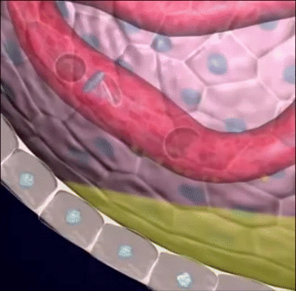

Slide 20
Reabsorption
The peritubular capillaries reabsorb several materials
  Some water
  Glucose
  Amino acids
  Ions
Some reabsorption is passive, most is active
Most reabsorption occurs in the proximal convoluted tubule
Copyright © 2003 Pearson Education, Inc. publishing as Benjamin Cummings
Slide 15.15

Slide 21
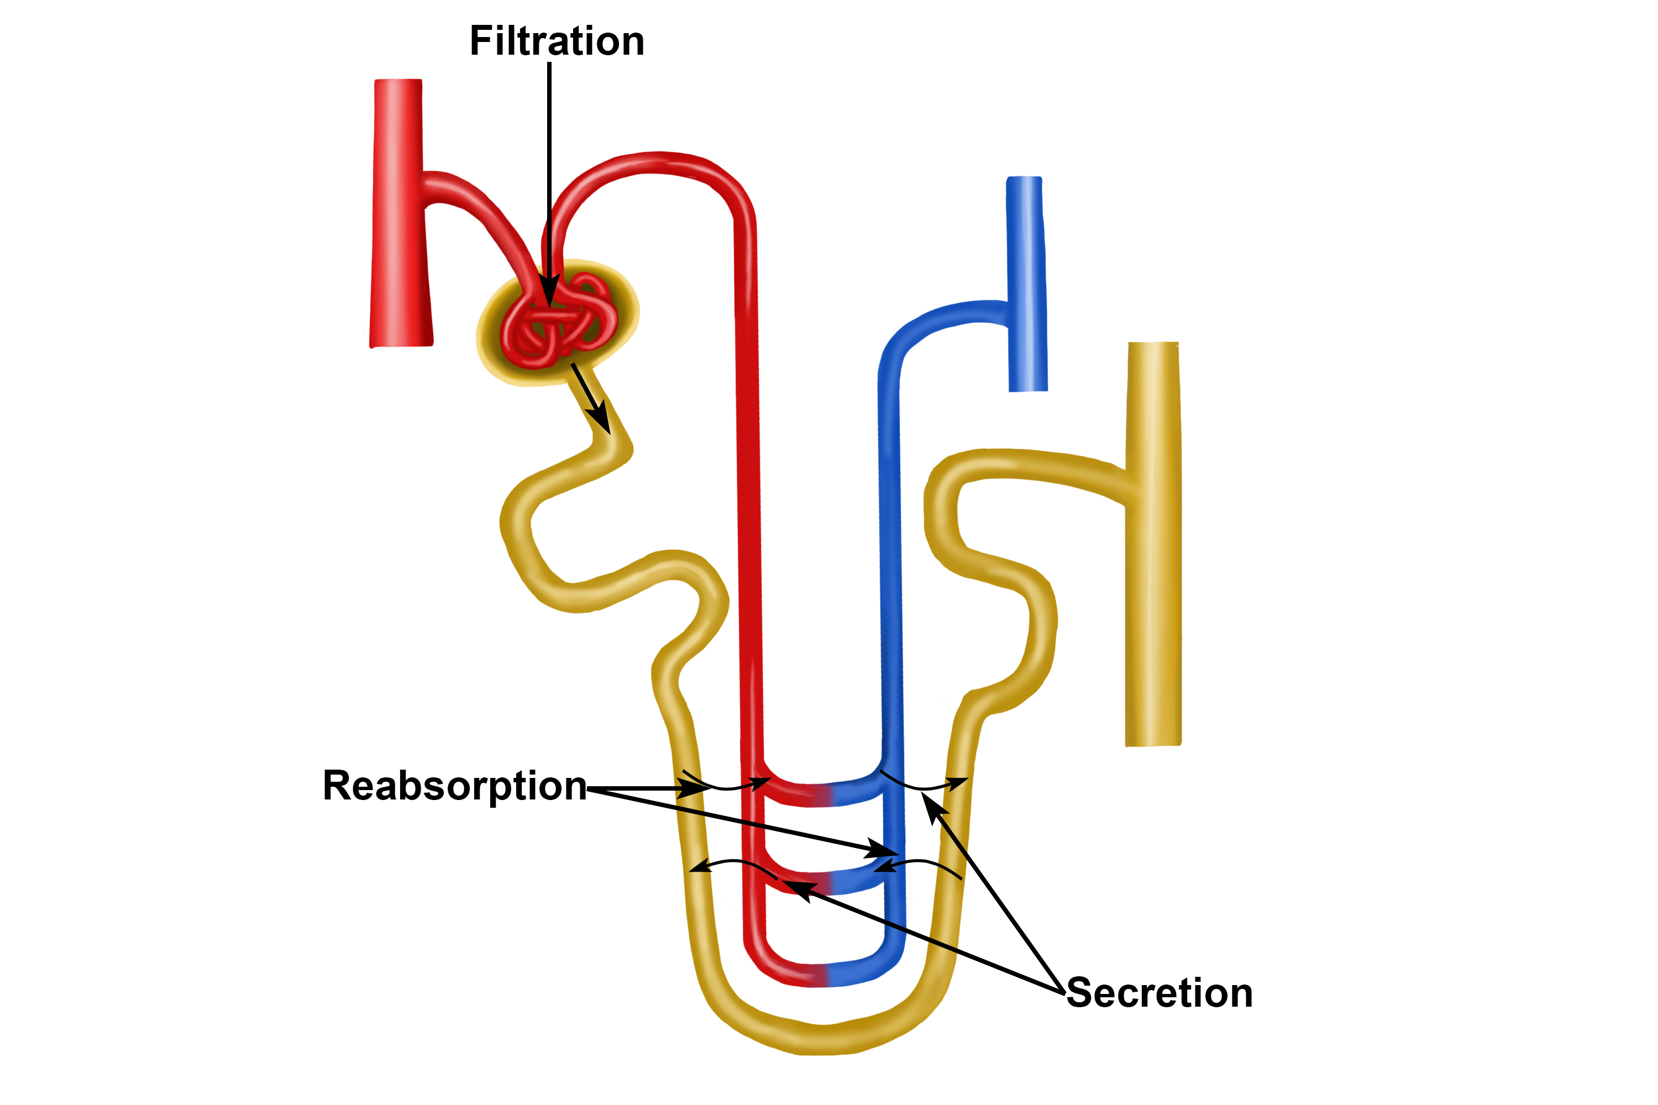

Slide 22
Materials Not Reabsorbed
Nitrogenous waste products
  Urea
  Uric acid
  Creatinine
Excess water
What are substances going to make?
Copyright © 2003 Pearson Education, Inc. publishing as Benjamin Cummings
Slide 15.16

Slide 23
Secretion – Reabsorption in Reverse
Some materials move from the peritubular capillaries into the renal tubules
  Hydrogen and potassium ions
  Creatinine
Materials left in the renal tubule move toward the ureter via collecting duct
Copyright © 2003 Pearson Education, Inc. publishing as Benjamin Cummings
Slide 15.17

Slide 24
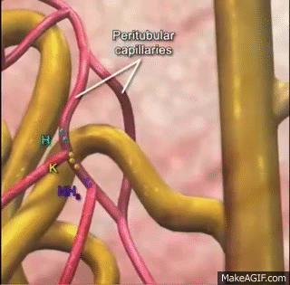

Slide 25
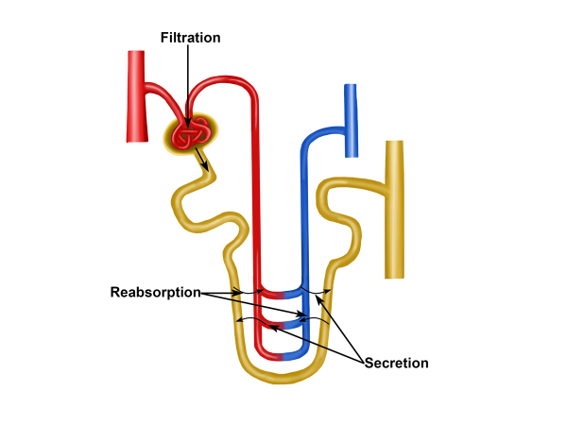

Slide 26
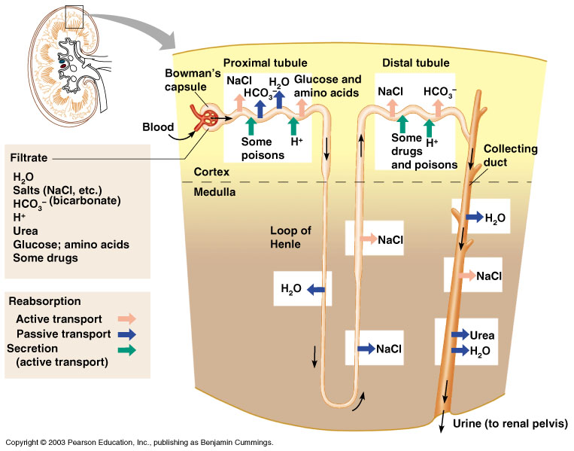
Formation of Urine
Figure 15.5
Copyright © 2003 Pearson Education, Inc. publishing as Benjamin Cummings
Slide 15.18

Slide 27
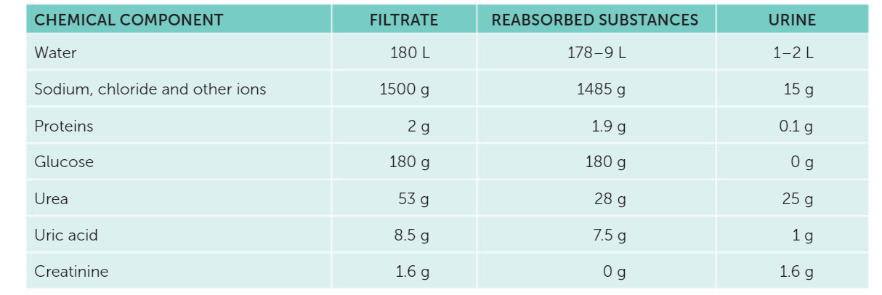
Composition of urine

Slide 28
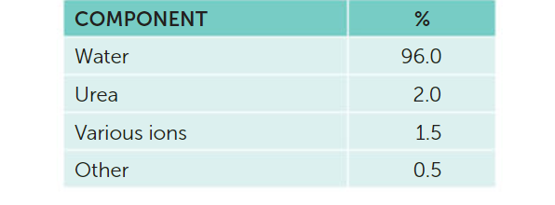
Composition of urine

Slide 29
Ureters
Slender tubes attaching the kidney to the bladder
  Continuous with the renal pelvis
  Enter the posterior aspect of the bladder
Runs behind the peritoneum
Peristalsis aids gravity in urine transport
Copyright © 2003 Pearson Education, Inc. publishing as Benjamin Cummings
Slide 15.20

Slide 30
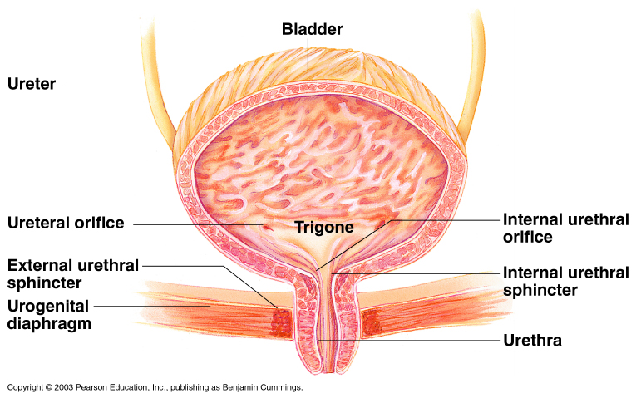
Urinary Bladder
Smooth, collapsible, muscular sac
Temporarily stores urine
Figure 15.6
Copyright © 2003 Pearson Education, Inc. publishing as Benjamin Cummings
Slide 15.21a

Slide 31
Urinary Bladder
Trigone – three openings
  Two from the ureters
  One to the urethrea
Figure 15.6
Copyright © 2003 Pearson Education, Inc. publishing as Benjamin Cummings
Slide 15.21b

Slide 32
Urinary Bladder Wall
Three layers of smooth muscle (detrusor muscle)
Mucosa made of transitional epithelium
Walls are thick and folded in an empty bladder
Bladder can expand significantly without increasing internal pressure
Copyright © 2003 Pearson Education, Inc. publishing as Benjamin Cummings
Slide 15.22

Slide 33
Urethra
Thin-walled tube that carries urine from the bladder to the outside of the body by peristalsis
Release of urine is controlled by two sphincters
  Internal urethral sphincter (involuntary)
  External urethral sphincter (voluntary)
Copyright © 2003 Pearson Education, Inc. publishing as Benjamin Cummings
Slide 15.23

Slide 34
Urethra Gender Differences
Length
  Females – 3–4 cm (1 inch)
  Males – 20 cm (8 inches)
Location
  Females – along wall of the vagina
  Males – through the prostate and penis
Copyright © 2003 Pearson Education, Inc. publishing as Benjamin Cummings
Slide 15.24a

Slide 35
Urethra Gender Differences
Function
  Females – only carries urine
  Males – carries urine and is a passageway for sperm cells
Copyright © 2003 Pearson Education, Inc. publishing as Benjamin Cummings
Slide 15.24b

Slide 36
Micturition (Voiding)
Both sphincter muscles must open to allow voiding
  The internal urethral sphincter is relaxed after stretching of the bladder
  Activation is from an impulse sent to the spinal cord and then back via the pelvic splanchnic nerves
  The external urethral sphincter must be voluntarily relaxed
Copyright © 2003 Pearson Education, Inc. publishing as Benjamin Cummings
Slide 15.25

Slide 37
Maintaining Water Balance
Normal amount of water in the human body
  Young adult females – 50%
  Young adult males – 60%
  Babies – 75%
  Old age – 45%
Water is necessary for many body functions and levels must be maintained
Copyright © 2003 Pearson Education, Inc. publishing as Benjamin Cummings
Slide 15.26

Slide 38
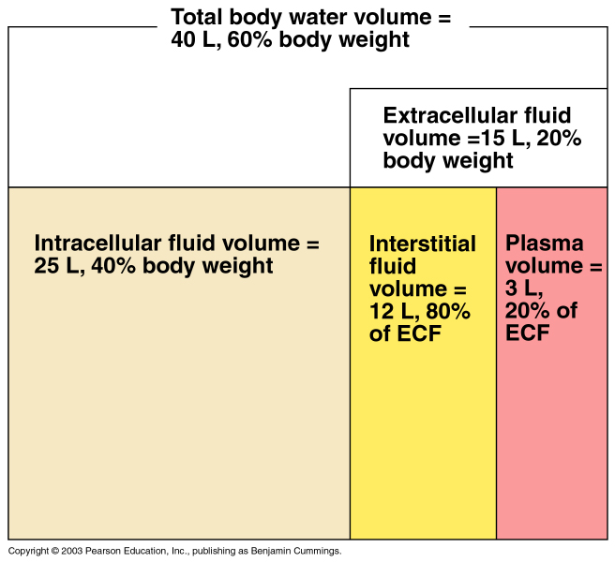
Distribution of Body Fluid
Intracellular fluid (inside cells)
Extracellular fluid (outside cells)
  Interstitial fluid
  Blood plasma
Figure 15.7
Copyright © 2003 Pearson Education, Inc. publishing as Benjamin Cummings
Slide 15.27

Slide 39
The Link Between Water and Salt
Changes in electrolyte balance causes water to move from one compartment to another
  Alters blood volume and blood pressure
  Can impair the activity of cells
Copyright © 2003 Pearson Education, Inc. publishing as Benjamin Cummings
Slide 15.28

Slide 40
Maintaining Water Balance
Water intake must equal water output
Sources for water intake
  Ingested foods and fluids
  Water produced from metabolic processes
Sources for water output
  Vaporization out of the lungs
  Lost in perspiration
  Leaves the body in the feces
  Urine production
Copyright © 2003 Pearson Education, Inc. publishing as Benjamin Cummings
Slide 15.29

Slide 41
Maintaining Water Balance
Dilute urine is produced if water intake is excessive
Less urine (concentrated) is produced if large amounts of water are lost
Proper concentrations of various electrolytes must be present
Copyright © 2003 Pearson Education, Inc. publishing as Benjamin Cummings
Slide 15.30

Slide 42
Regulation of Water and Electrolyte Reabsorption
Regulation is primarily by hormones
  Antidiuretic hormone (ADH) prevents excessive water loss in urine
  Aldosterone regulates sodium ion content of extracellular fluid
    Triggered by the rennin-angiotensin mechanism
Cells in the kidneys and hypothalamus are active monitors
Copyright © 2003 Pearson Education, Inc. publishing as Benjamin Cummings
Slide 15.31

Slide 43
Maintaining Acid-Base Balance in Blood
Blood pH must remain between 7.35 and 7.45 to maintain homeostasis
  Alkalosis – pH above 7.45
  Acidosis – pH below 7.35
Most ions originate as byproducts of cellular metabolism
Copyright © 2003 Pearson Education, Inc. publishing as Benjamin Cummings
Slide 15.33a

Slide 44
Maintaining Acid-Base Balance in Blood
Most acid-base balance is maintained by the kidneys
Other acid-base controlling systems
  Blood buffers
  Respiration
Copyright © 2003 Pearson Education, Inc. publishing as Benjamin Cummings
Slide 15.33b

Slide 45
Blood Buffers
Molecules react to prevent dramatic changes in hydrogen ion (H⁺) concentrations
  Bind to H⁺ when pH drops
  Release H⁺ when pH rises
Three major chemical buffer systems
  Bicarbonate buffer system
  Phosphate buffer system
  Protein buffer system
Copyright © 2003 Pearson Education, Inc. publishing as Benjamin Cummings
Slide 15.34

Slide 46
The Bicarbonate Buffer System
Mixture of carbonic acid (H₂CO₃) and sodium bicarbonate (NaHCO₃)
Bicarbonate ions (HCO₃–) react with strong acids to change them to weak acids
Carbonic acid dissociates in the presence of a strong base to form a weak base and water
Copyright © 2003 Pearson Education, Inc. publishing as Benjamin Cummings
Slide 15.35

Slide 47
Respiratory System Controls of Acid-Base Balance
Carbon dioxide in the blood is converted to bicarbonate ion and transported in the plasma
Increases in hydrogen ion concentration produces more carbonic acid
Excess hydrogen ion can be blown off with the release of carbon dioxide from the lungs
Respiratory rate can rise and fall depending on changing blood pH
Copyright © 2003 Pearson Education, Inc. publishing as Benjamin Cummings
Slide 15.36

Slide 48
Renal Mechanisms of Acid-Base Balance
Excrete bicarbonate ions if needed
Conserve or generate new bicarbonate ions if needed
Urine pH varies from 4.5 to 8.0
Copyright © 2003 Pearson Education, Inc. publishing as Benjamin Cummings
Slide 15.37

Slide 49
Developmental Aspects of the Urinary System
Functional kidneys are developed by the third month
Urinary system of a newborn
  Bladder is small
  Urine cannot be concentrated
Copyright © 2003 Pearson Education, Inc. publishing as Benjamin Cummings
Slide 15.38a

Slide 50
Developmental Aspects of the Urinary System
Control of the voluntary urethral sphincter does not start until age 18 months
Urinary infections are the only common problems before old age
Copyright © 2003 Pearson Education, Inc. publishing as Benjamin Cummings
Slide 15.38b

Slide 51
Aging and the Urinary System
There is a progressive decline in urinary function
The bladder shrinks with aging
Urinary retention is common in males
Copyright © 2003 Pearson Education, Inc. publishing as Benjamin Cummings
Slide 15.39

